Slide 1
Using Text Mining to Explore Consumer Priority on Keyboards
Team Kee-Bored
CIS 4680 - Advanced Data Analytics by: Bryan Marquez, Lei Wang, Jarrod Griffin, JenWen Chang, Calvin Truong

Slide 2
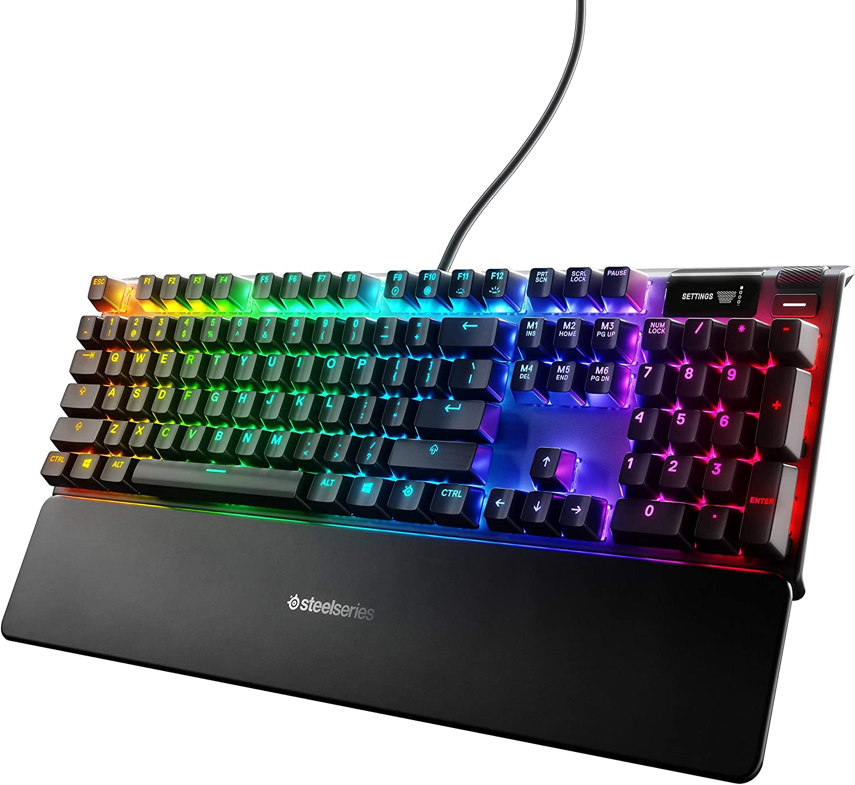


Background

Slide 3
Research Questions
We will use text mining to try to answer these questions:
What features do people care about in computers? Are people generally more positive towards enthusiast type keyboards? Are people generally unhappy with keyboards that are considered ‘generic’?

Slide 4
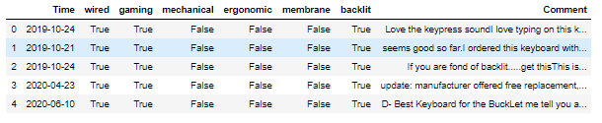
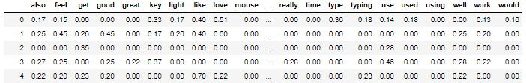
Preprocessing and Cleaning
Collect raw data (web scraper)
Combine keyboard texts
Eliminate all non-english reviews
Normalize corpus
Apply regular expressions
Tokenize corpus
Filter out stopwords (exclude negative words)
Lemmatize corpus
Notes:
Calvin

Slide 5
Clustering Analysis
Most important step for discovering what topics consumers find important
N Gram Bag of Words model with n=4 words
Number of topics was decided to be 5
CountVectorizer
(min_df=2, max_df=0.95)
Normalized Corpus Matrix Ready for LDA
Notes:
Jarrod
We have a good idea of what features people are interested in

Slide 6
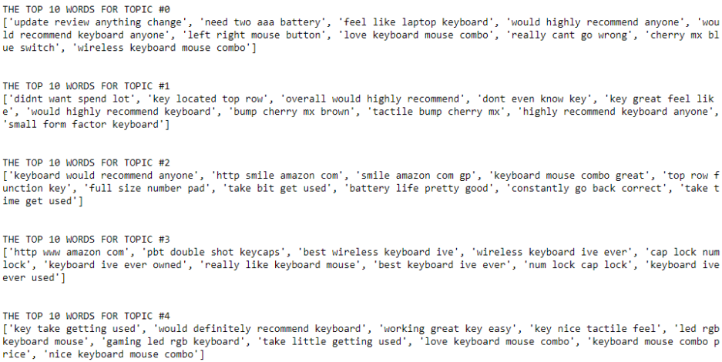
Latent Dirichlet Allocation
Using the CountVectorizer to get the bag of words
Using the matrix for the LDA methodt Allocation
Notes:
JenWen

Slide 7
Results - Features Extracted
Topic 0
Wireless Mechanical Keyboard and Mouse Combo
“Need two aaa battery” - Wireless
“Cherry mx blue switch” - Mechanical
“Love keyboard mouse combo” - Keyboard and Mouse Combo
Topic 1
Budget Mechanical
“Didnt want spend lot” - Budget
“Tactile bump cherry mx” - Mechanical
Notes:
Jarrod
We have a good idea of what features people are interested in
A wireless mechanical keyboard and mouse combo is a great feature set for a product that is targeted mainly at casual users who need both items.
Mechanical keyboards are preferred by typists, gamers, and enthusiasts. They are generally the most expensive keyboard type, so offering a budget option can attract consumers.

Slide 8
Results - Features Extracted (Con’t)
Topic 2
Basic Wireless Keyboard and Mouse Combo
“Keyboard mouse combo great” - Keyboard and Mouse Combo
“Battery life pretty good” - Wireless
“Take time get used” - Basic Design
Topic 3
Basic Wireless
“Best wireless keyboard ive” - Wireless
No other interesting unique topic
Notes:
Jarrod
We have a good idea of what features people are interested in

Slide 9
Results - Features Extracted (Con’t)
Topic 4
Gaming Wired Keyboard and Mouse Combo
“Gaming led rgb keyboard” - Gaming oriented design
“Love keyboard mouse combo” - Keyboard and Mouse Combo
Notes:
Jarrod
We have a good idea of what features people are interested in

Slide 10
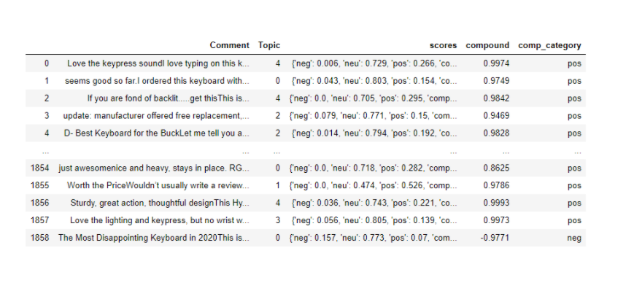

Sentiment Analysis with VADER Lexicon

Slide 11
Hard to Detect Negative Reviews?
Positive review is more common than negative reviews
VADER is not smart enough
Sarcasm
Partially positive and negative
Negative words (eg. not, no, don’t, etc)

Slide 12
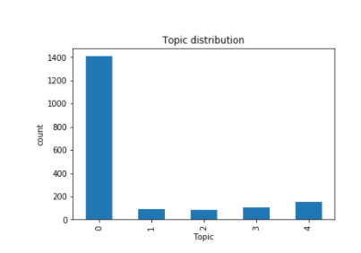
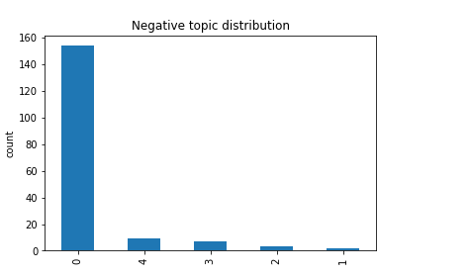

Topic modeling with Sentiment
Topic 0: Wireless mechanical keyboard
Topic 1: Budget Mechanical
Topic 2: Basic Wireless combo
Topic 3: Basic Wireless
Topic 4: Gaming Wired
Notes:
Topic 0: wireless mechanical keyboard
Topic 1: budget
Topic 2:Basic Wireless combo
Topic 3: Basic Wireless
Topic 4: Gaming Wired

Slide 13
Conclusions
offering product combos seems to be the greatest factor when purchasing keyboards for the general consumer
improve marketing strategies to get greater sales and positive reception
focus for keyboard manufacturer research and development or quality control
Notes:
Bryan

Slide 14
Discussion: Improvement
Get a more diverse amount of reviews from Amazon
Improve LDA model, consider optimizing topic amounts
Account for reviews that are fake (review bombing)

Slide 15
Resources
Jack, L., & Tsai, Y. (2015, January). Using text mining of amazon reviews to explore user-defined product highlights and issues. In Proceedings of the International Conference on Data Mining (DMIN) (p. 92).
Portilla, Jose. NLP - Natural Language Processing with Python.

